Slide 1
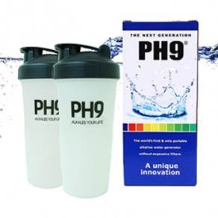
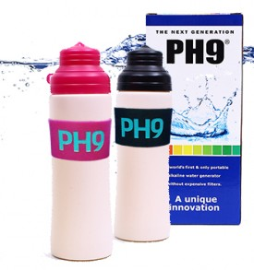
Portable Alkaline Water Bottle
Alkaline Water Generator System
1

Slide 2
Portable Alkaline Water Bottle
PH9 GENERATOR
PH9 GLOBAL GENERATOR
Contains no pollutants or hazardous materials
There is a plentiful balance of minerals
Water with plenty of oxygen
Soft Water (as opposed to hard water)
Water with a pH level that is safe for everybody from infants to the elderly (pH level 7.5 – 9.2)
Small water molecule clusters (better absorption)
Possible to remove free oxygen radicals
Prevents oxidization (can keep fresh longer)
2

Slide 3
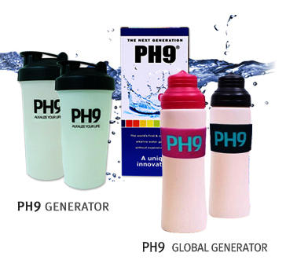
Effective on diet, overall body constitution and increased physical strength.
4 Gastrointestinal Improvements & Effects
Chronic Diarrhea
Indigestion
Hyper Acidic Stomach
Improvement of Abnormal Gastrointestinal Fermentation
★ USFDA Registered Product
★ Approved as a Medical Device in the Republic of Korea

Slide 4
Benefits of the Portable Alkaline Water Bottle: PH9 Generator
The PH9 Generator is an alkaline water bottle made with the GC-58 Alkaline Compound which has high stiffness, impact resistance, chemical resistance, strain immunity traits and low thermal sealing strength. (The product will not deform even when water at 100 degrees Celsius is put into the bottle)
Inside the alkaline water bottle, there are no additional filters, sticks, or devices that react with the water placed inside to alkalize it. All of the alkalizing materials are in the actual makeup of the bottle itself. (Patent Number: 10-1393158)
The product utilizes the patented GC-58 Alkaline Compound within the material of the bottle which in turn reacts with the water placed inside the bottle. This gives the PH9 Generator the ability to alkalize water, and also maintain freshness of other drinkable liquids placed inside, without the use of additional filters or devices. Also, this makes it very convenient for the user to clean and rinse the bottle. There are many convenient features of the PH9 Generator to the everyday user for everyday use.
Alkaline Water Generator! What makes it so good?
Functionality and Effectiveness of Alkaline Water
- Removes free oxygen radicals and protects the DNA within cells.
Removes cholesterol
Disinfects for prevention of skin disease
Helps with chronic diarrhea, indigestion, hyper acidic stomach, and abnormal gastrointestinal fermentation
Helps with post workout recovery because the smaller water clusters absorb more readily into the body.
Benefits and Aid: Indigestion, Excessive Stomach Acid, Constipation, and Hangovers.

Slide 5
Miracle Water!
The Alkalizing Effects of the PH9 Generator
Diet
Improved Skin Condition
Improved Physical Constitution
Post-Workout Recovery
Ionized water gives plenty of energy by providing a lot of oxygen
Balances our body’s acidic state caused by various factors such as diet
Overall improvement in body constitution
Anti-oxidant; eliminates free oxygen radicals by decreasing Oxidation Reduction Potential (ORP).
Helps with post-workout recovery
The optimum natural health solution
Has a sterilizing effect on the water
Positive effects on skin care and weight loss
Helps alleviate complications associated with the atopy skin condition
Contains and releases minerals such as calcium, magnesium, iron, among others
Lowers cholesterol
Breaks down water molecule clusters into smaller ones for better absorption into the body
“Activates” water and produces high OH and Calcium ions

Slide 6
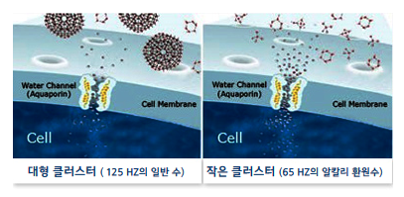
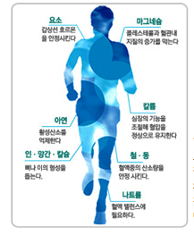
Water Molecule Cluster Comparison
Big Water Molecule Clusters
(Regular Water at 125 HZ)
Small Water Molecule Clusters
(Alkaline Water at 65 HZ)
Element
Stabilizes Thyroid Hormone
Magnesium
Suppresses Cholesterol in Blood Vessels
Alkaline water is referred to as mysterious, water of life, miracle water, and the last present given to man by God. It is water with plenty of active hydrogen and calcium among other minerals that will stabilize and maintain a healthy body.
Among 70 odd minerals, 22 are necessary for healthy bodily function. Among these the minerals that the body needs small amounts of are just as important for overall health and the body reacts just as sensitively to them.
Potassium
Controls Heart Function Maintaining Normal Blood Pressure
Iron
Suppresses Free Oxygen Radicals
Iron - Copper
Stabilizes Oxygen in Blood
Sodium
Balances Blood

Slide 7
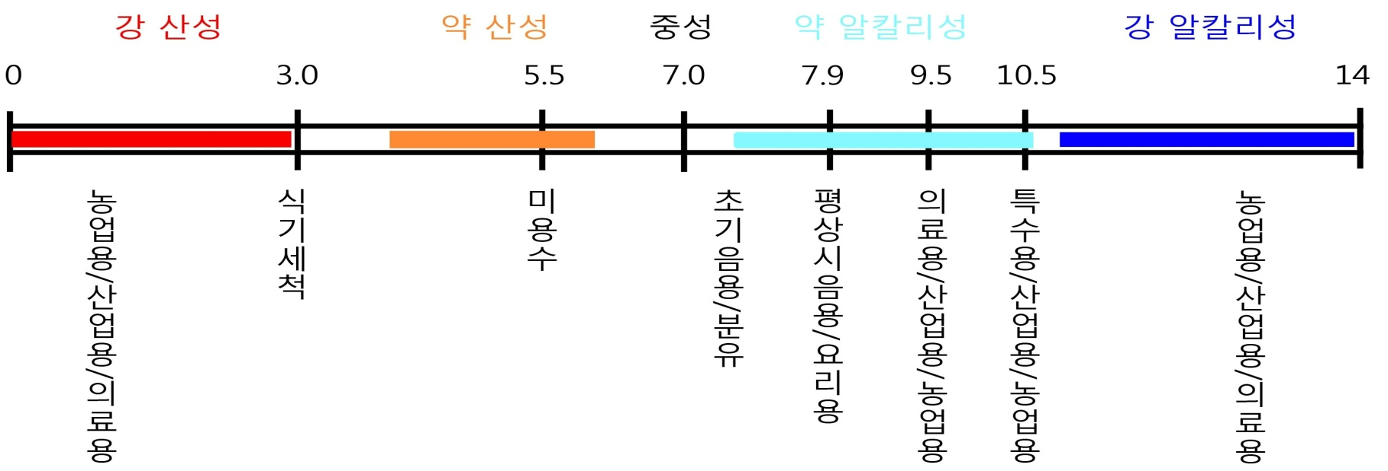
PH9 Generator Directions of Use
Fill PH9 Generator with water or beverage (juice, coffee, milk, etc.) and shake for 1 minute before use.
PH9 Generator is the world’s first portable alkaline water bottle that does not require any additional devices or filters. The material of the bottle itself has alkalizing properties and will raise the pH level of the
water that is put into the Generator.
It does not matter how much water you put in the bottle. Any amount of water that is placed inside will become alkaline between the pH levels of 7.5 – 9.2 (PH9 Generator Volume: 700mL)
It is recommended to drink 2 liters of water per day.
To lead a healthy and beautiful life, use the PH9 Generator for
everyday use.
pH Scale
Strong Acidic
Weak Acidic
Neutral
Weak Alkaline
Strong Alkaline
Agricultural
Industrial
Medical
Cleaning
Sterilizing
Sanitizing
Cosmetic
Weak Ion Water
Baby Formula
Regular Water Cooking
PH9 - GENERATOR
Agricultural
Industrial
Medical
7

Slide 8
What is the Alkaline Water Generator ?
01. Principles of the Alkaline Water Generator.
In the natural world, there are materials that come into a chemical reaction with water to generate hydrogen and alkalize the water. These materials are called alkaline earth metals and are effective and have a high level of reaction in generating alkaline water. These alkaline earth metals are in an unstable state and easily release electrons. The fact that they can easily release electrons means that they can easily become acidic and the electrons will reduce other materials. When the alkaline earth metals come into contact with water, one molecule of the alkaline earth metal and two molecules of water will react and the alkaline earth metal will not be isolated and a hydration alkaline earth metal will be formed and a portion of the electrons released by the alkaline earth metals will be hydrogen gas and the rest will be left in the water. Hydration alkaline earth metal will be ionized and an OH- ion will be formed, and the alkaline earth metal will be oxidized and the water will be reduced. This increase in OH- ions will raise the level of the pH thus creating alkaline water.
02. Conditions of Alkaline Water
Contains no pollutants or hazardous materials
Water with plenty of oxygen
pH level between 7 -14
Possible to remove free oxygen radicals
There is a plentiful balance of minerals
Soft Water (as opposed to hard water)
Small water molecule clusters (better absorption)
Prevents oxidization (can keep fresh longer)
There are many types of water consumed by people, but if one chooses to drink alkaline water, it is a way to improve overall health.

Slide 9
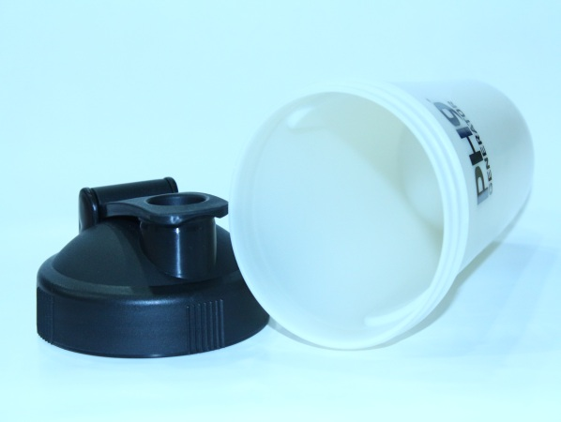
Specifications
Materials
Alkaline Earth Metals, Minerals and PE
Capacity
600ml & 700ml bottle
Usage Period
PH9 Generator’s properties will remain effective for approximately 1,000 uses.
PH9 Alkaline Water Bottle (700mL)

Slide 10
